Slide 1

RELIVING THE PAST WITH AI AND VR
A Synergistic Pipeline for Text-to-Geometry Historical Reconstruction
Tayyab Imran
Hamna Imran
Abdul Haseeb Arif
2023-BS-AI-019
2023-BS-AI-017
2023-BS-AI-033
Zain Sattar
Ahmad Mustafa
Javed Mehmood
2023-BS-AI-052
2023-BS-AI-016
2023-BS-AI-029
Zubair Niazi
2023-BS-AI-006

Slide 2

The Reconstruction Challenge
Bridging the gap between fragmented ruins and digital heritage.

Slide 3



Current Approaches & Limitations
Photogrammetry
Generative AI
Excellent for scanning existing ruins with high fidelity. However, it acts as a "fog" of data—unable to reconstruct missing elements like collapsed roofs or eroded columns. It captures what is, not what was.
Tools like text-to-image generators can "imagine" missing parts but suffer from "hallucinations." They frequently ignore physics and architectural rules, creating wobbly columns or inventing non-existent windows.

Slide 4






Our Synergistic Pipeline
Text Analysis (NLP)
Rule-Based Modeling
Hybrid Rendering
AI extracts rigorous architectural facts (height, material, style) from historical texts like Vitruvius, converting vague descriptions into structured data.
Seamlessly blending solid, AI-generated reconstructions with NeRF scans of the real ruins, matched perfectly via Inverse Rendering.
A procedural engine converts data into precise 3D geometry. Instead of guessing, it builds using "architectural Lego blocks" defined by history.

Slide 5
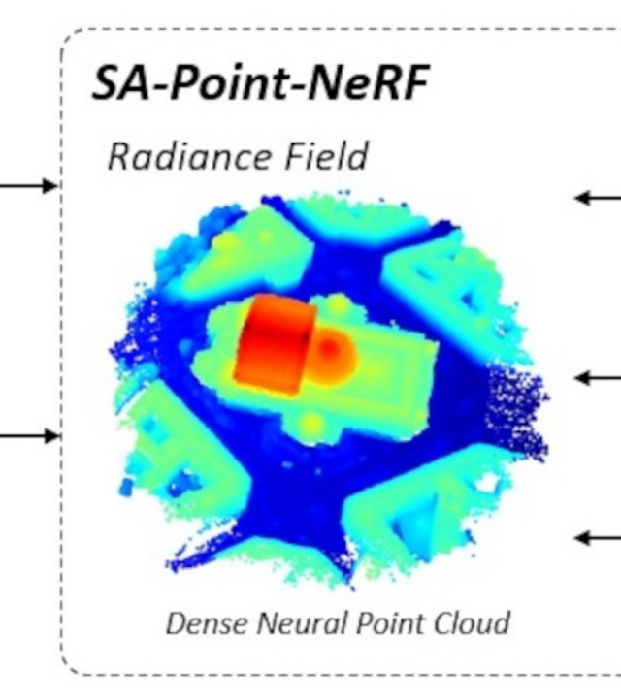

The NeRF Foundation
We utilize Neural Radiance Fields (NeRF) to capture the complex, "fog-like" reality of archaeological sites. Unlike standard 3D meshes, NeRFs handle complex lighting and geometry with photorealistic accuracy.
This volumetric data serves as the "Canvas" onto which our rule-based AI paints the missing "Solid" history.
*Standard NeRF volumetric rendering equation

Slide 6

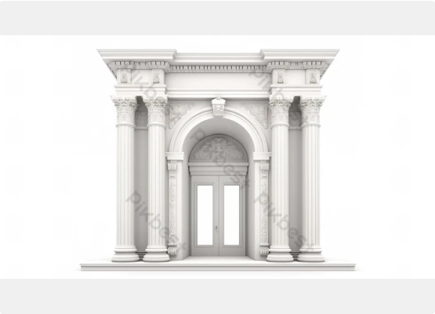
Logic-Driven Reconstruction
Instead of allowing AI to "be creative," we force it to be an architect.
•
Input: "Corinthian Column, 12.5m height, Granite."
•
Process: The system retrieves the specific mathematical rules for a Corinthian capital and extrudes the shaft to exact specifications.
•
Outcome: Mathematically perfect geometry that respects physics and historical accuracy, unlike wobbly generative meshes.

Slide 7
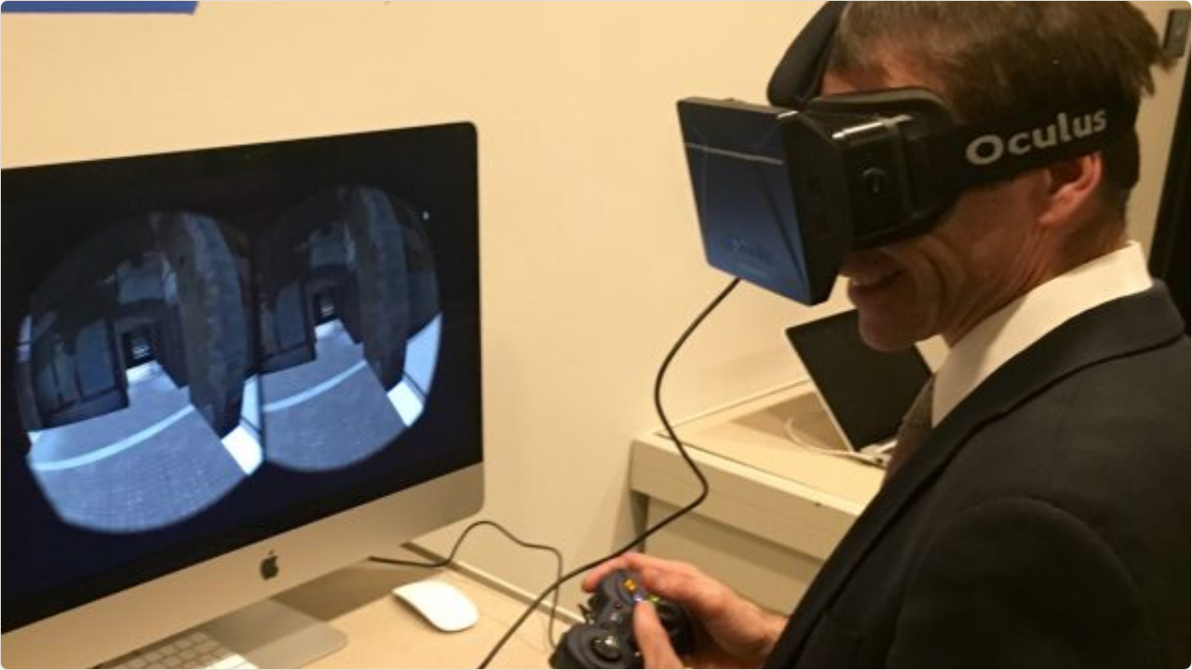

Immersive "AI Multiverse"
Moving beyond static screens to full VR immersion. Users can step into the past, toggle between the "Ruined" state and the "Reconstructed" state, and visualize different historical possibilities with scientific confidence.

Slide 8



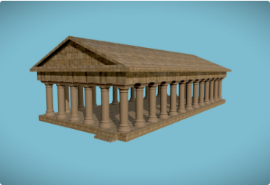
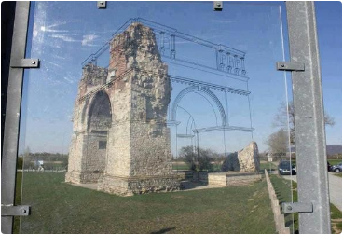
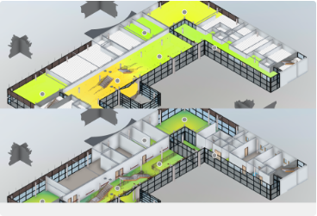
Validation: The "Destruction Test"
To validate accuracy, we digitally destroyed 40% of the Temple of Hephaestus model and tasked our AI with rebuilding it using only text descriptions.
Original Model
AI Reconstruction
Truth Heatmap

Slide 9
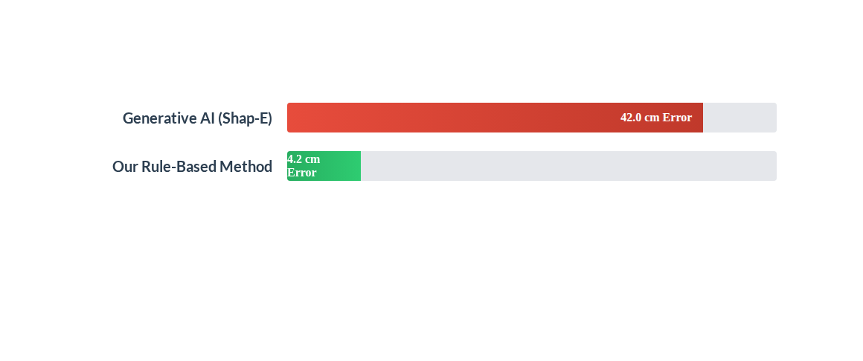
Performance: Accuracy & Precision
Our logic-driven approach resulted in a 10x reduction in geometric error compared to standard creative AI models. The AI correctly identified building materials and sizes 92% of the time.

Slide 10
Significance of the Study
"
Moving digital heritage from "Art" to "Science."
By enforcing strict architectural rules, we prevent AI hallucinations, allowing users to visit scientifically accurate "Digital Twins" of lost civilizations.

Slide 11



Future Roadmap
Phase 1: Mobile
Phase 2: Expansion
Phase 3: Real-time
Porting the pipeline to mobile devices using "3D Gaussian Splatting" for faster rendering.
Incorporating new architectural styles beyond Greco-Roman, such as Gothic and Islamic designs.
Enabling real-time, on-site AR reconstruction for tourists at active archaeological sites.

Slide 12
Questions?
Thank you for your attention.

Slide 13







Image Sources
https://pub.mdpi-res.com/remotesensing/remotesensing-16-01341/article_deploy/html/images/remotesensing-16-01341-ag.png?1712981818
Source: www.mdpi.com
https://img.pikbest.com/wp/202348/featured-door-white-background-3d-rendering-of-front-with-classic-arch-featuring-corinthian-column-and-triangular-tympanum_9775216.jpg!w700wp
Source: pikbest.com
https://media.sketchfab.com/models/1ad677148a6b490bb48c1c1a9275b3d3/thumbnails/67e5ead8cb484033b5aba99673dfe585/81f64d24020b4c53b44281ae9a6c4f0a.jpeg
Source: sketchfab.com
https://i.redd.it/8vu1qrr3l7nz.jpg
Source: www.reddit.com
https://developer.doc.autodesk.com/bPlouYTd/A360-hyperion-develop-4/_images/volumetric-vs-planar-heatmaps.png
Source: aps.autodesk.com
https://michigan.it.umich.edu/news/wp-content/uploads/2017/12/Oplontis-Oculus-Rift-e1512574756132.jpg
Source: michigan.it.umich.edu

